Slide 1
CS 4350: Fundamentals of Software Engineering CS 5500: Foundations of Software Engineering Lesson 2.1 Documenting Your Design
Jon Bell, John Boyland, Mitch Wand
Khoury College of Computer Sciences
© 2021 Jonathan Bell, John Boyland and Mitch Wand. Released under the CC BY-SA license

Slide 2
Outline of this lesson
Why documenting your design is important, and why it is different from just writing comments in your program.
Introduction to one way of documenting your design: CRC cards

Slide 3
Learning Objectives for this Lesson
By the end of this lesson you should be able to:
Explain what it means to document a design
Describe the importance of having a shared vocabulary
for teams,
for communicating with management
for dealing with clients
Illustrate the basics of CRC cards

Slide 4
Remember the Challenge: Controlling Complexity
Software systems must be comprehensible by humans
Which humans?
The other members of your team
The folks who will maintain and modify your system
Management
Your clients
and ...
You, a week from now or 6 weeks from now
4

Slide 5
A Design is more than code
Design is about how your code relates to the real world
Design is about the organization of the code
Design is about the relationships between different pieces of the code
So: you need a different language to talk about your design
Remember Principle #2: Design Your Data!

Slide 6
Communication Requires a Shared Vocabulary
You and your teammates need to have a common understanding of the things in your program.
What are their names?
What do they represent?
How do they interact?
You get to make up the names. But you should make them Good Names, of course
There are standard names for many of these interactions. These are called Design Patterns.

Slide 7
Design Languages
We'll study two design languages
CRC Cards
UML (Unified Modeling Language) [next lesson]
These are very different languages for describing designs
different level of formality
different scope

Slide 8
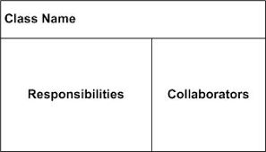
CRC Cards
A CRC card looks like this:

Slide 9
CRC Cards
Class
the name of a "thing" in your program
could be a class, interface, type, etc.
Responsibilities
the main job of this "thing" in the program
should be simple: Remember the Single Responsibility Principle
Collaborators
the other "things" with which this thing interacts
for us this means the things with which this thing is coupled
includes at least: all the things that this thing uses, and all the things that use this thing, at least directly
Some books say to list just the things that this thing depends upon.

Slide 10
The Agile Alliance says:
CRC cards (for Class, Responsibilities, Collaborators) are an activity bridging the worlds of role-playing games and object-oriented design.
With the intent of rapidly sketching several different ideas for the design of some feature of an object-oriented systems, two or more team members write down on index cards the names of the most salient classes involved in the feature. The cards are then fleshed out with lists of the responsibilities of each class and the names of collaborators, i.e. other classes that they depend on to carry out their own responsibilities.
The next step is to validate – or invalidate as the case may be – each design idea by playing out a plausible scenario of the computation, each developer taking on the role of one or more classes.
https://www.agilealliance.org/glossary/crc-cards

Slide 11
CRC Cards in Practice
Typically used during early analysis, especially during team discussions.
Low-tech
4x6 index cards
They aren't pretty.
They aren't something you ever want to show your customers or even your own upper management.
Each card is a concrete symbol for a thing in the program during discussion
Kind of like thinking on a whiteboard, but...
Cards can be stacked, moved, etc. to illustrate proposed relationships
If you come out of a group meeting and your CRC cards aren't smudged, dog-eared, with lots of scratched-out bits, you probably weren't really trying.
https://www.cs.odu.edu/~zeil/cs330/live/website/Slides/crc/page/crc.html

Slide 12
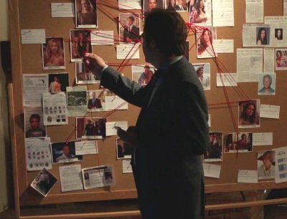
The metaphor: Sketching the conspiracy

Slide 13
CRC Cards for us
HW1 will ask you to use CRC Cards to document an existing design.
You may not be able to identify all the classes that use your class. Don't worry too hard about that.
We will also ask you to put one more thing on your CRC cards:
State: the piece of state that an object of this class keeps.

Slide 14
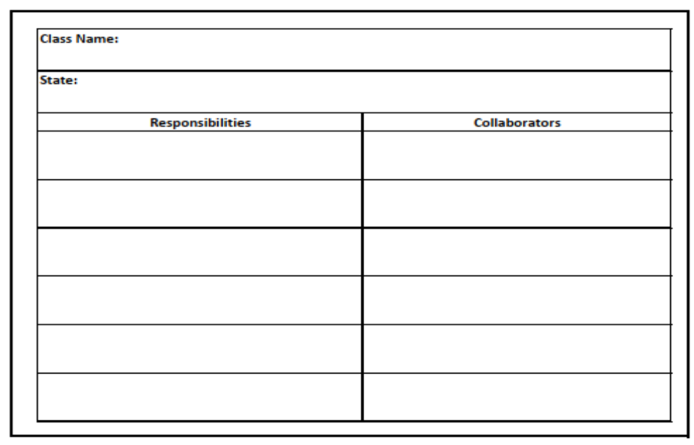
CRC Card Template
This template is available in Canvas under Files/Week 02, as a spreadsheet for typing on and as a png that you can print out and write on by hand.

Slide 15
CRC Card for TemperatureSensor
// temperatures are measured in Celsius
type Temperature = number
interface TemperatureSensor {
// return the current temperature
// at the sensor location
getTemperature () : Temperature
}
Class Name: | TemperatureSensor (interface)
State: | none
Responsibilities |  | Collaborators
defines interface for thermometers in the system |  | RefrigeratorThermometer
 |  | OvenThermometer
 |  | etc.
 |  | TemperatureMonitor
CRC cards are supposed to be informal, so don’t get hung up on emulating the exact words or the exact layout I've used here.

Slide 16
TemperatureMonitor (1)
class TemperatureMonitor {
constructor(
// the sensors
private sensors: TemperatureSensor[],
// map from sensor to its location
private sensorLocationMap: SensorLocationMap,
private maxTemp: Temperature,
private minTemp: Temperature,
private alarm: IAlarm,
) { }
// sensor in range?
private isSensorInRange (sensor:TemperatureSensor) : boolean {
const temp: Temperature = sensor.getTemperature()
return ((temp < this.minTemp) || (temp > this.maxTemp))
}
Here's a slightly more elaborate TemperatureMonitor
It monitors multiple sensors
And it knows where each sensor is
Better division into one method/one job than our earlier version.

Slide 17
TemperatureMonitor (2)
// if the any of the sensors is out of range, sound the alarm
public checkSensors(sensor:TemperatureSensor): void {
this.sensors.forEach(sensor => {
if (!(this.isSensorInRange(sensor))) {
this.soundAlarm(sensor)
}
})
}
private soundAlarm (sensor) {
const location = this.sensorLocationMap.getLocation(sensor)
this.alarm.soundAlarm(location)
}
}

Slide 18
CRC Card for TemperatureMonitor
Class Name: | TemperatureMonitor
State: | Some sensors, maxTemp, minTemp, The alarm to sound, Map from sensors to locations
Responsibilities |  | Collaborators
if any of the sensors is out of range, tell the alarm to sound at its location |  | TemperatureSensor
 |  | SensorLocationMap
 |  | IAlarm

Slide 19
IAlarm
// sound alarm for issue at the given location
interface IAlarm { soundAlarm(location:Location): void }
Class Name: | Ialarm (interface)
State: | none
Responsibilities |  | Collaborators
Defines interface for classes that will sound an alarm |  | TemperatureMonitor
 |  | all implementations of IAlarm

Slide 20
SensorLocationMap
class SensorLocationMap {
private locationMap : Map<TemperatureSensor,Location> = new Map ()
// get the location, if any. If none, throw error
public getLocation (sensor:TemperatureSensor) : Location {
if (this.locationMap.has(sensor)) {
return this.locationMap.get(sensor)
} else {
throw new Error (`sensor ${sensor} location unknown`)
}
}
// methods to add and remove sensors from the map...
}

Slide 21
CRC Card for SensorLocationMap
Class Name: | SensorLocationMap
State: | Map from Sensors to their Location
Responsibilities |  | Collaborators
Maintain the map from Sensors to their Location |  | TemperatureMonitor

Slide 22
FireAlarm
A hypothetical implementation of IAlarm
Class Name: | FireAlarm
State: | socket for communicating with Fire Dept
Responsibilities |  | Collaborators
when sounded, call the FireDept |  | IFireDept
when FireDept responds, turn off alarm

Slide 23
Mapping the Conspiracy
Class Name: | SensorLocationMap
State: | Map from Sensors to their Location
Responsibilities |  | Collaborators
Maintain the map from Sensors to their Location |  | TemperatureMonitor
Class Name: | TemperatureMonitor
State: | sensors, maxTemp, minTemp, alarm
Responsibilities |  | Collaborators
if any of the sensors is out of range, tell the alarm to sound at its location |  | TemperatureSensor
 |  | SensorLocationMap
 |  | IAlarm
Class Name: | TemperatureSensor (interface)
State: | none
Responsibilities |  | Collaborators
establish interface for thermometers in the system |  | RefrigeratorThermometer
 |  | OvenThermometer
 |  | etc.
 |  | TemperatureMonitor
Class Name: | Ialarm (interface)
State: | none
Responsibilities |  | Collaborators
Interface for classes that will sound an alarm |  | TemperatureMonitor
 |  | all implementations of IAlarm
Class Name: | FireAlarm
State: | socket for communicating with Fire Dept
Responsibilities |  | Collaborators
when sounded, call the FireDept |  | IFireDept
when FireDept responds, turn off alarm

Slide 24
Review: Learning Objectives for this Lesson
You should now be able to:
Explain what it means to document a design
Describe the importance of having a shared vocabulary
for teams,
for communicating with management
for dealing with clients
Illustrate the basics of CRC cards

Slide 25
Next steps...
In our next lesson, we'll talk about UML, a far more elaborate system for documenting designs

